Slide 1
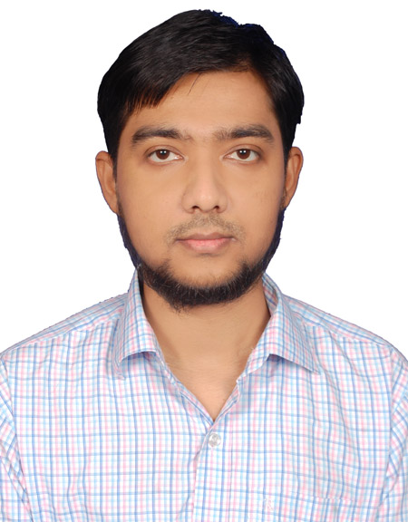
Full Stack Developer
Md Emtiaz Zaman

Slide 2
Work Experience
Full Stack Developer (October 2020 – Present)
Developer (March 2018– September 2020)
MYBD Techies
Responsibilities:
Work with development teams and product managers to develop software solutions
Develop client-side and server-side modules
Build the front-end of applications through appealing visual design
Develop and manage well-functioning databases for applications
Writing clean, functional code for front and back-end
Test software to ensure responsiveness and efficiency
Troubleshoot, debug and upgrade software
Build features and applications with a mobile responsive design
Write technical documentation

Slide 3
Education
Bachelor of Computer Science and Engineering
Institution : East West University.
Discipline : Computer Science and Engineering
Passing Year: Fall, 2015.
C.G.P. A : 2.60(In the scale of 4.00)
Higher Secondary Certificate (H.S.C)
Institution : Tejgaon College
Discipline : Science
Board : Dhaka
Passing Year: 2009
G.P. A : 3.10 (In the scale of 5.00)
Secondary School Certificate (S.S.C)
Institution : Banani Bidyaniketan School And College.
Discipline : Science
Board : Dhaka
Passing Year : 2007
G.P.A : 4.25 (In the scale of 5.00)

Slide 4






Front End Skills
HTML 55
CSS 35
Bootstrap 55
Javascript
JQuery
Vue Js

Slide 5




Backend Skills
PHP
MySQL
Laravel 8
Wordpress

Slide 6





Tools
NPM
Git
Vite
CPanel
Visual Studio Code

Slide 7
Project 1
Brand Name: Deltoid Academy
Type: Learning management system
Client Location: Australia
URL: https://deltoidacademy.com.au/
Features:
Registration and login system for parent and children
Parent can purchase any test module or learn module packages
according to their package type.
Trial exam and their result in graphs
Separate dashboard for parent, child/student and admin
Student dashboard has test exam , exam history, result display in various charts and take given assignment etc. functionality.
Parents can monitor their child’s activity using their dashboard.
Super Admin has separate dashboard panel to manage whole system.
Email invoice and purchase status notification
Cart system for purchase and payment gateway support for PayPal ,
AfterPay using credit card

Slide 8
Technologies:
Frontend:
Full responsive UI is hand coded using: HTML5, Css3 , Bootstrap5 from Photoshop design.
Page interactive functionalities are achieved using: Javascript, Jquery , owl.carousel.js and Highcharts .js.
Backend:
PHP and MySQL.
Wordpress using hand coded Worpress custom theme and Woocommerce.

Slide 9

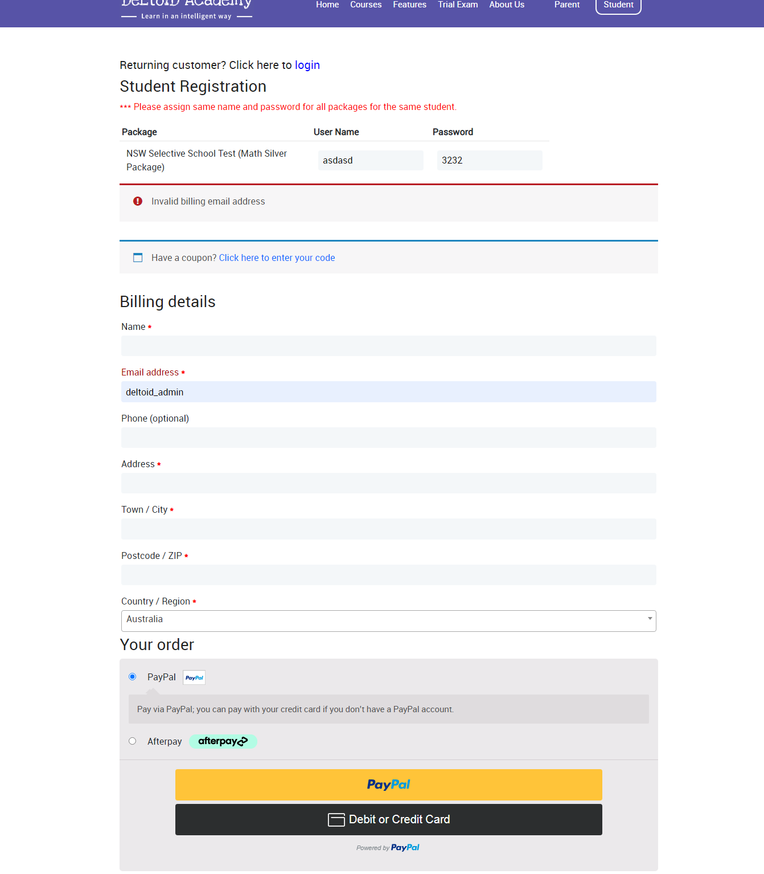
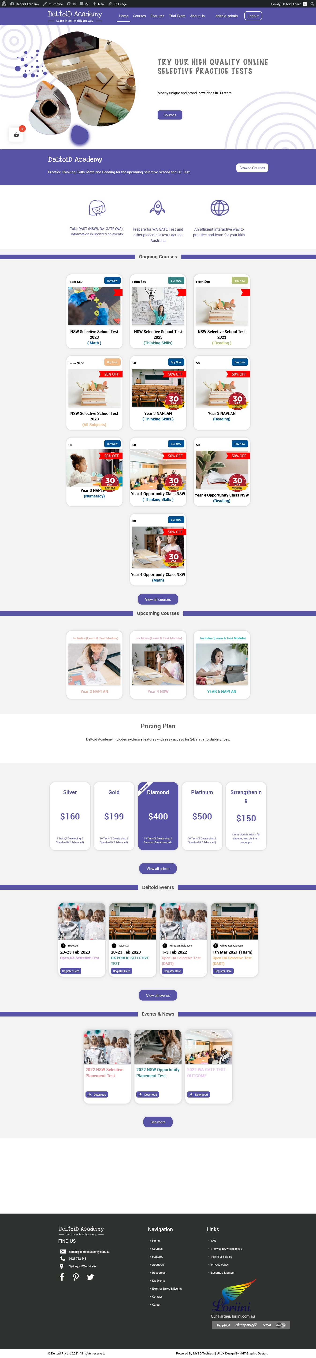
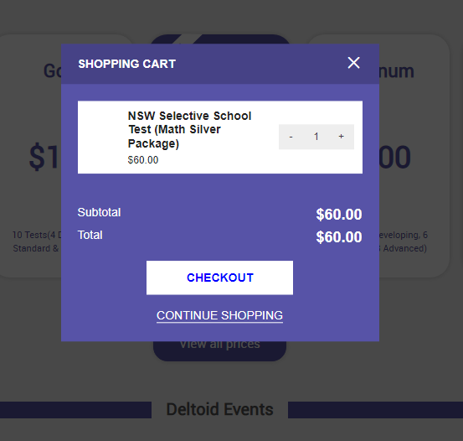
Screenshots :
Homepage
Shopping Cart
Student Registration and Payment

Slide 10
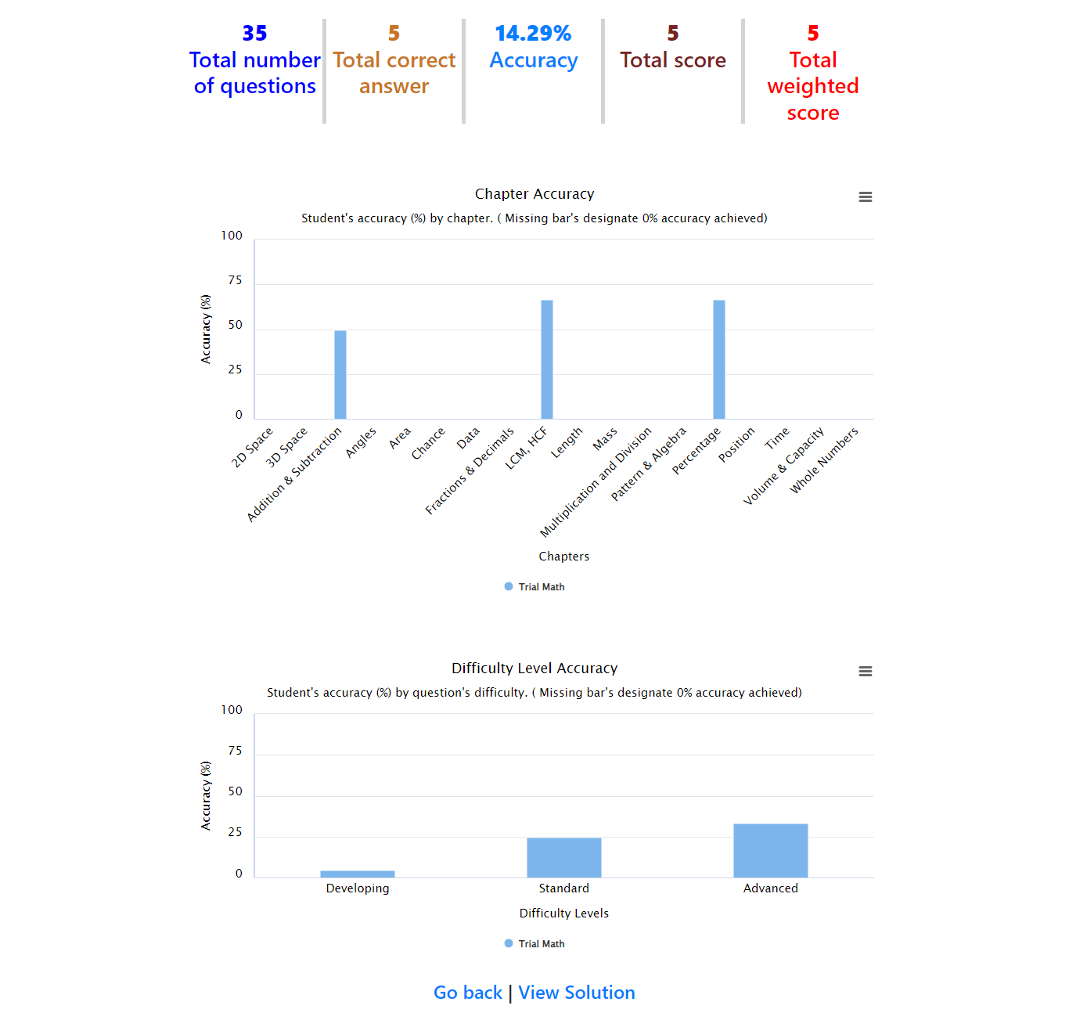
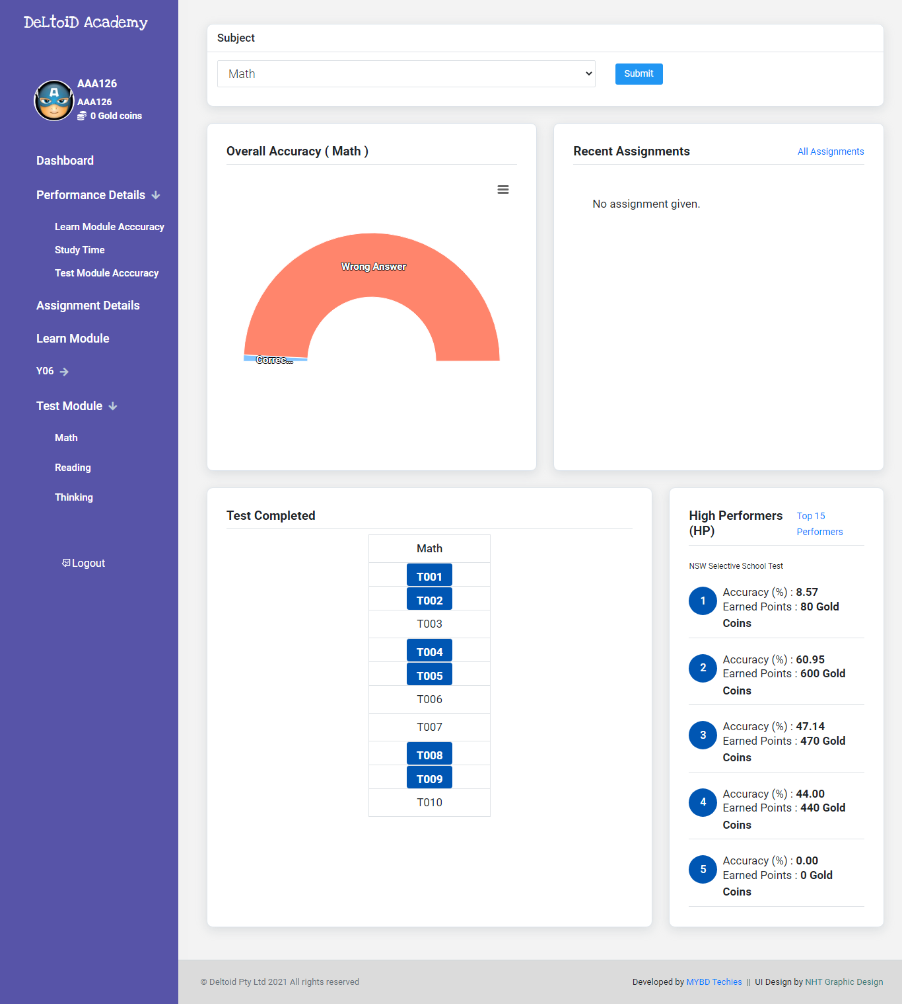
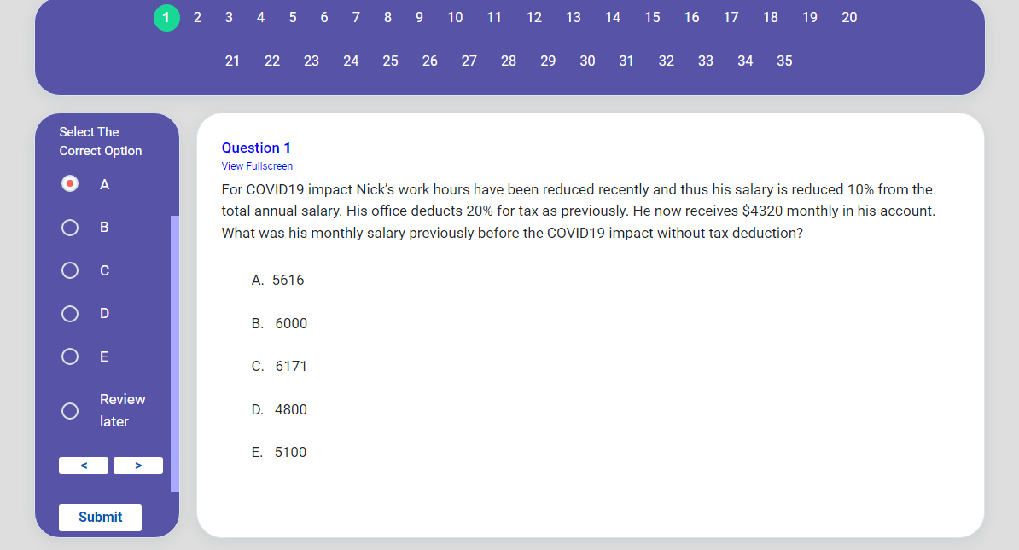
Screenshots :
Student Dashboard
MCQ Exam
Exam Result

Slide 11
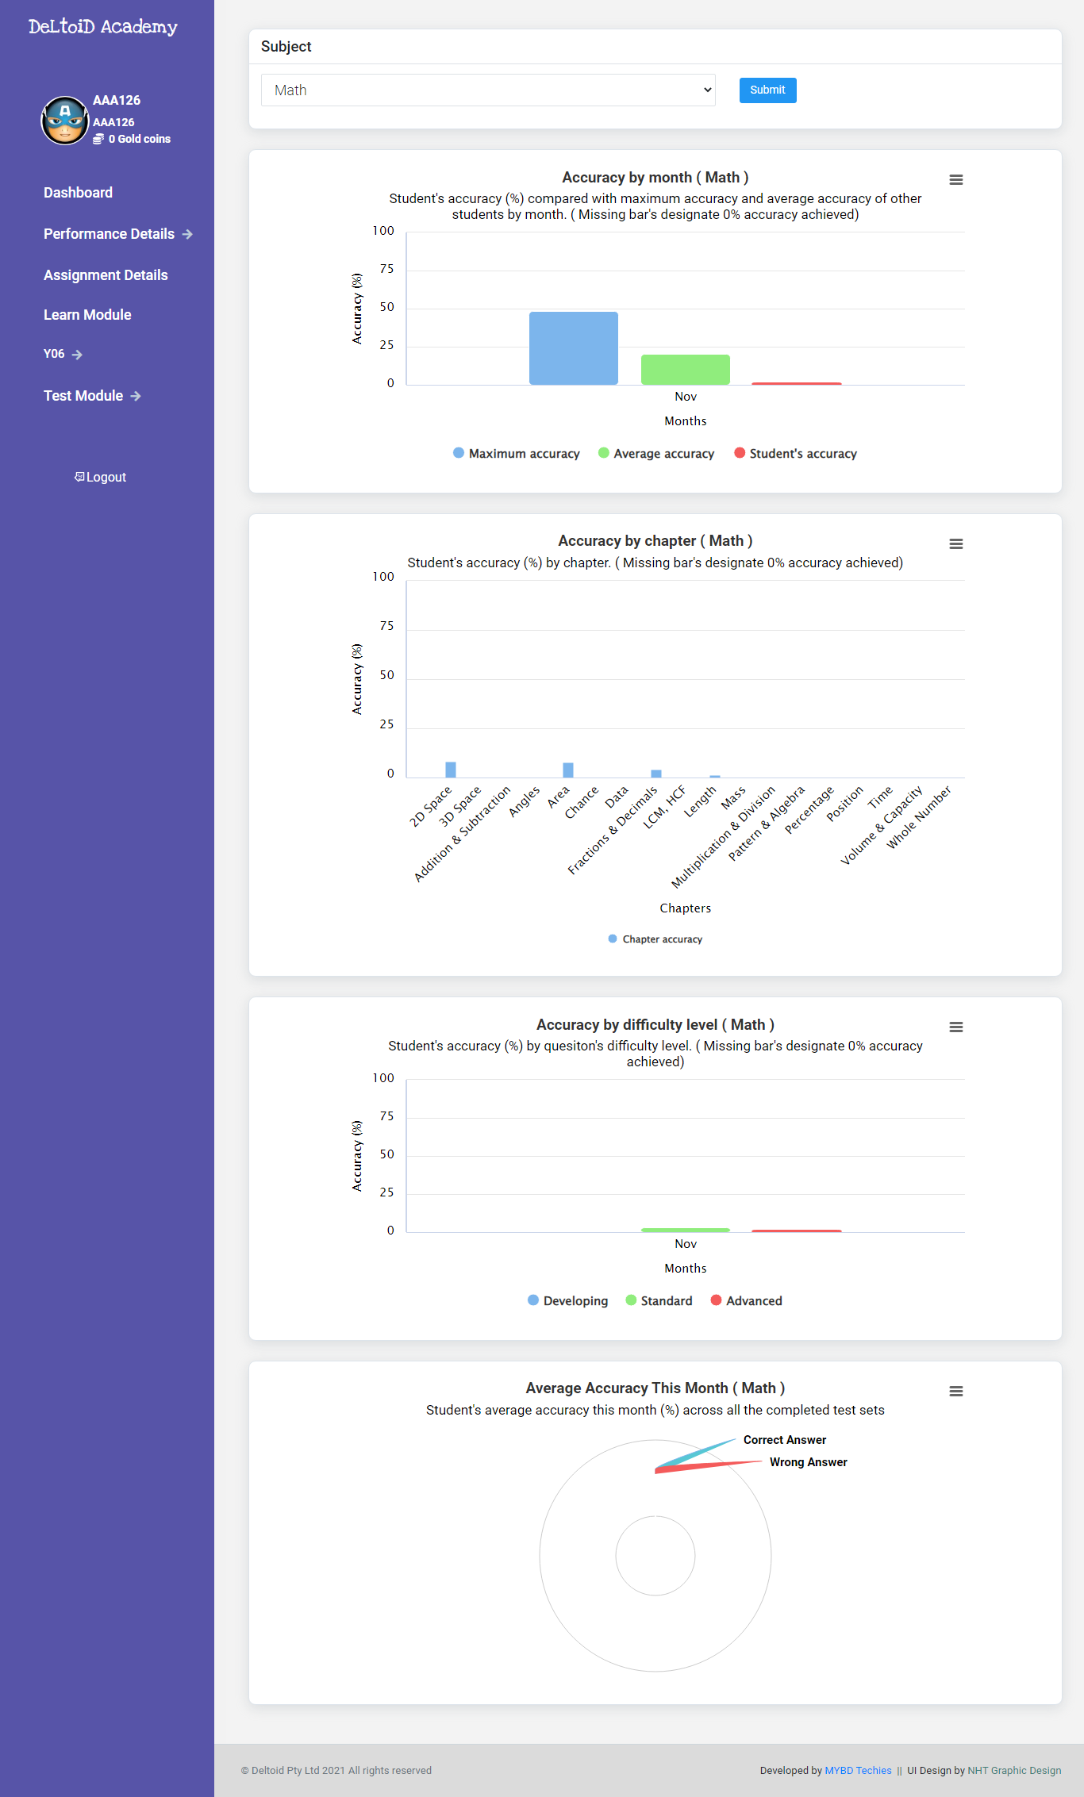
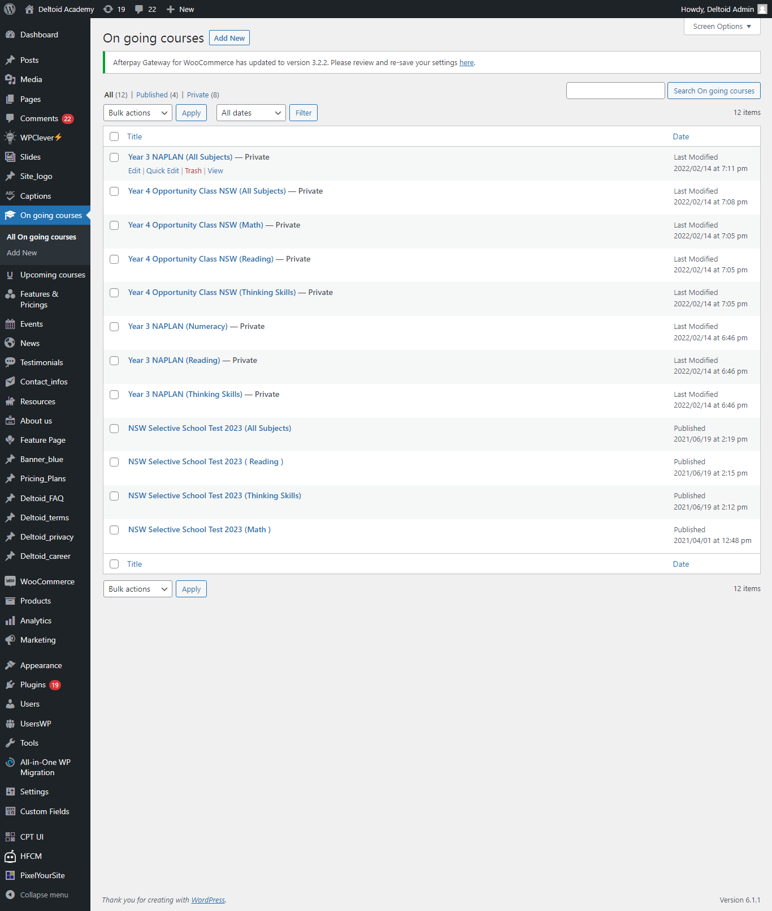
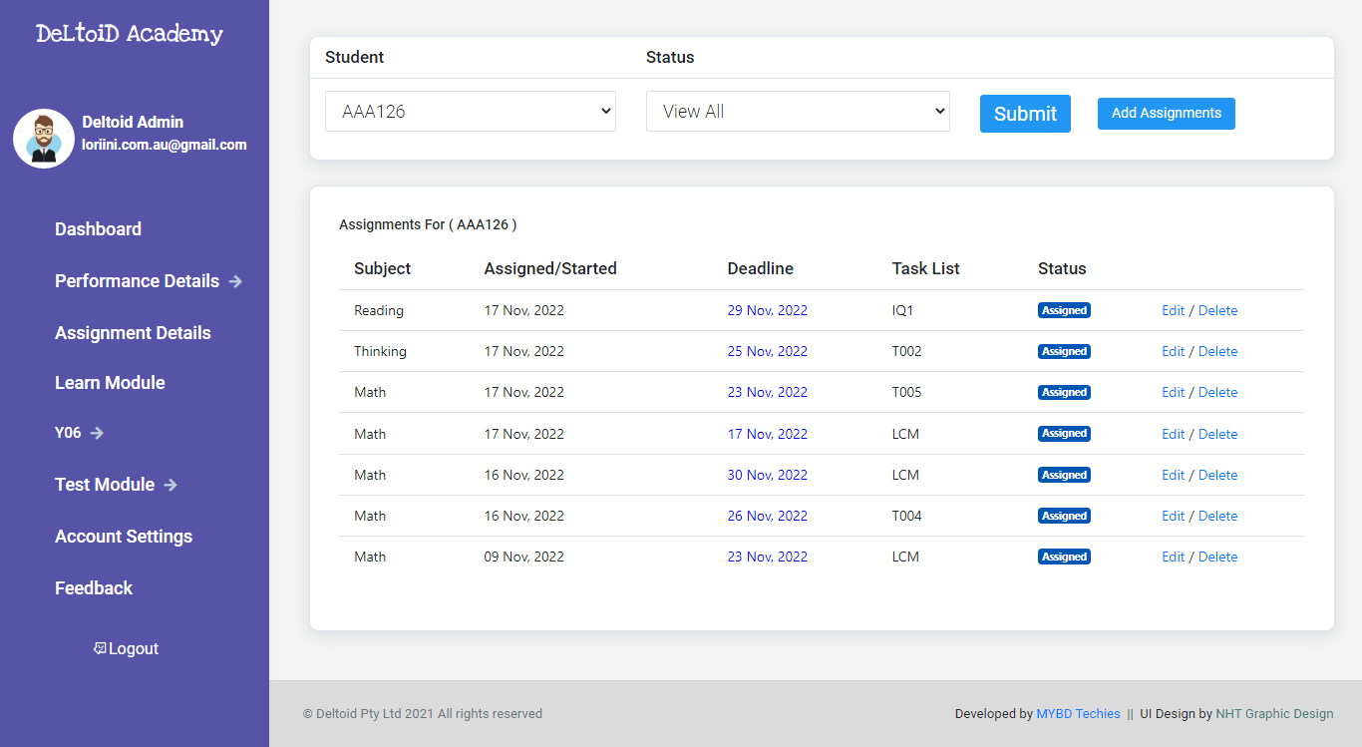
Screenshots :
Student Dashboard
Test Module accuracy
Parent Dashboard
New Assignment page
Super Admin Panel

Slide 12
Project 2
Brand Name: MKN Prefab Composite
Type: Company website
Client Location: Australia
URL: http://mknprefabcomposite.com.au/
Features:
Full responsive UI
Animated slider for image showcase
Visitor count using API
Online subscription and contact system
Portfolio gallery
Super Admin panel for content update

Slide 13
Technologies:
Frontend:
Full responsive UI is hand coded using: HTML5, Css3 , Bootstrap4.
Page interactive functionalities are achieved using: Javascript, Jquery , nivo slider.js
Backend:
Wordpress using hand coded Worpress custom theme
Third party PHP API

Slide 14
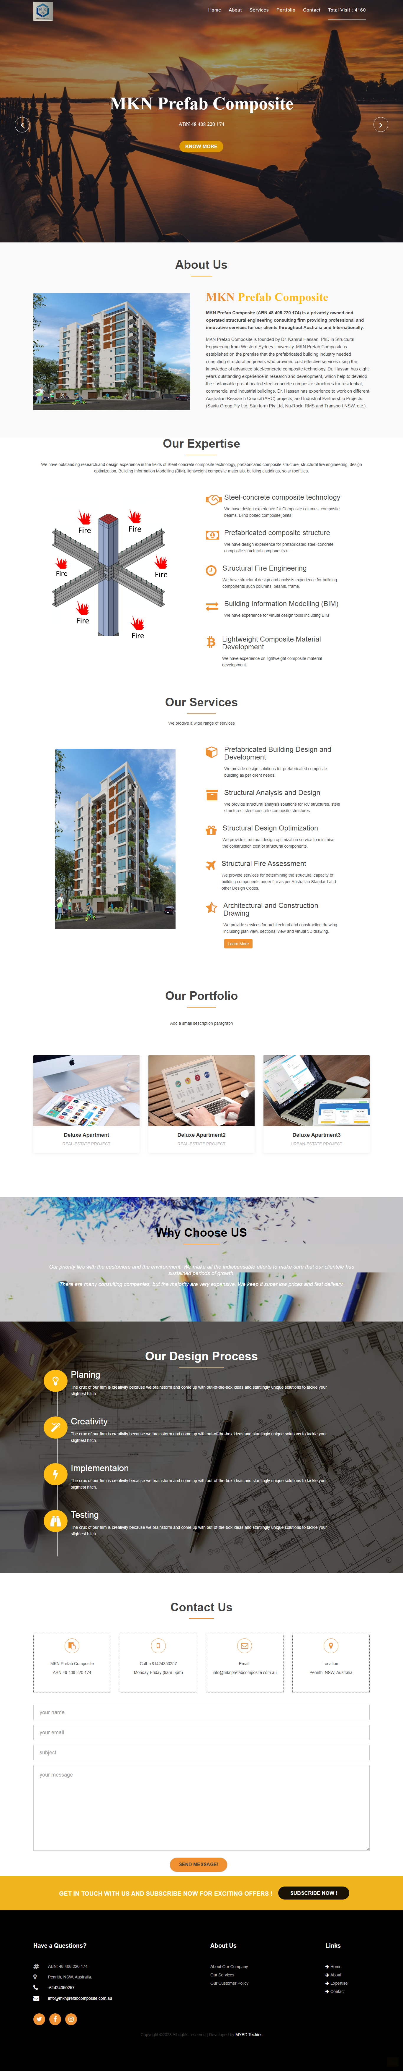
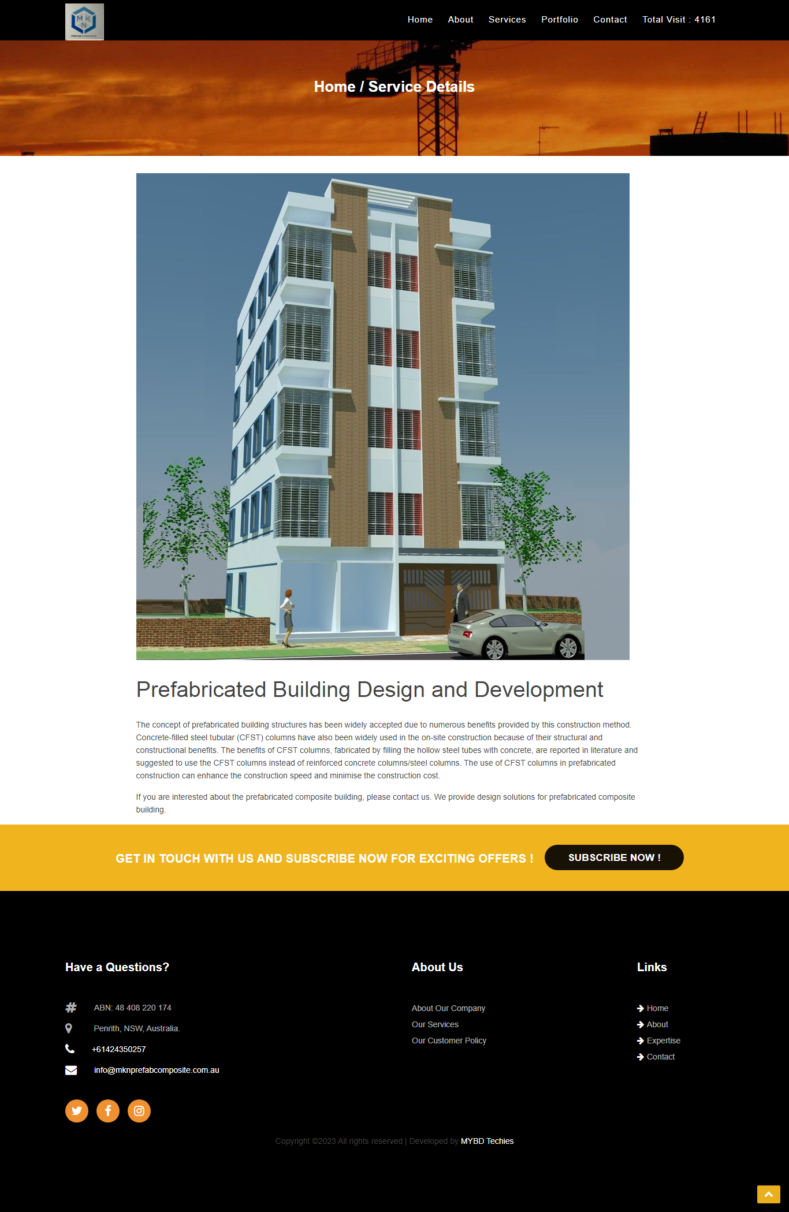
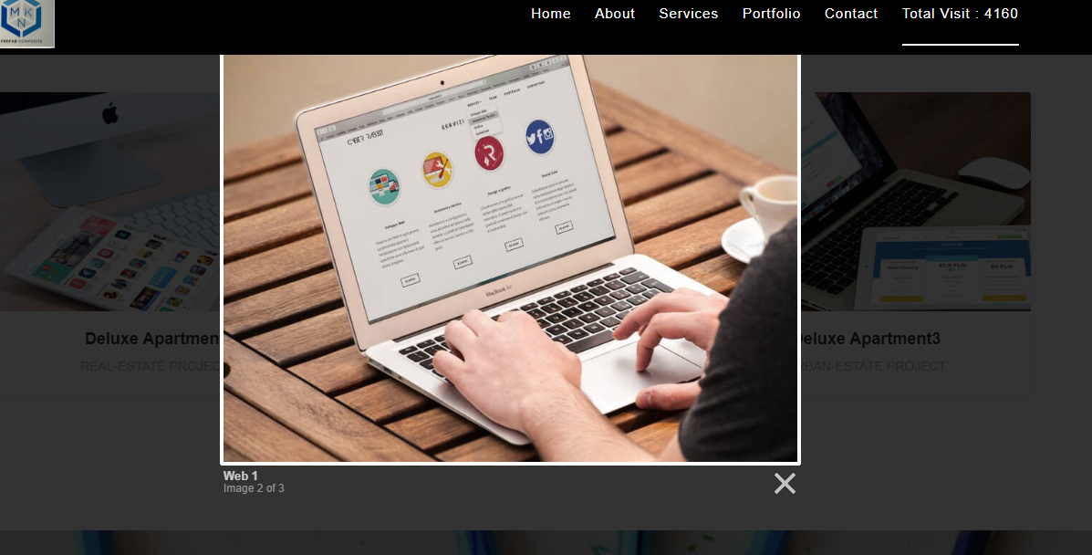
Screenshots :
Homepage
Gallery
Service Details

Slide 15
Project 3
Brand Name: Justrack GPS
Type: GPS Tracking System
Client Location: Malaysia
URL: https://s3.justrack.com.my
Features:
Real time data display in sidebar grid from socket received from vehicle's GPS device.
Real time vehicle position display on goggle map.
Real time marking of vehicle status.
Sidebar tab system for various functions.
Vehicle's black box data display on sidebar and excel csv export system.
User registration panel and control panel with various functionalities.
Various report generation and with csv report export system.
Separate mobile version for mobile devices.

Slide 16
Technologies:
Frontend:
UI is coded using: HTML5, Css3 , Bootstrap4
Grids and tables are created using jQuery Grid
Page’s interactive functionalities are achieved using Javascript and Jquery.
Map functionalities are achieved using leaflet.js.
For displaying data and interacting with backend AJAX and JSON decoding is used
Backend:
Socket technology was used for instant data transmission.
MySQL database
Third party PHP API

Slide 17
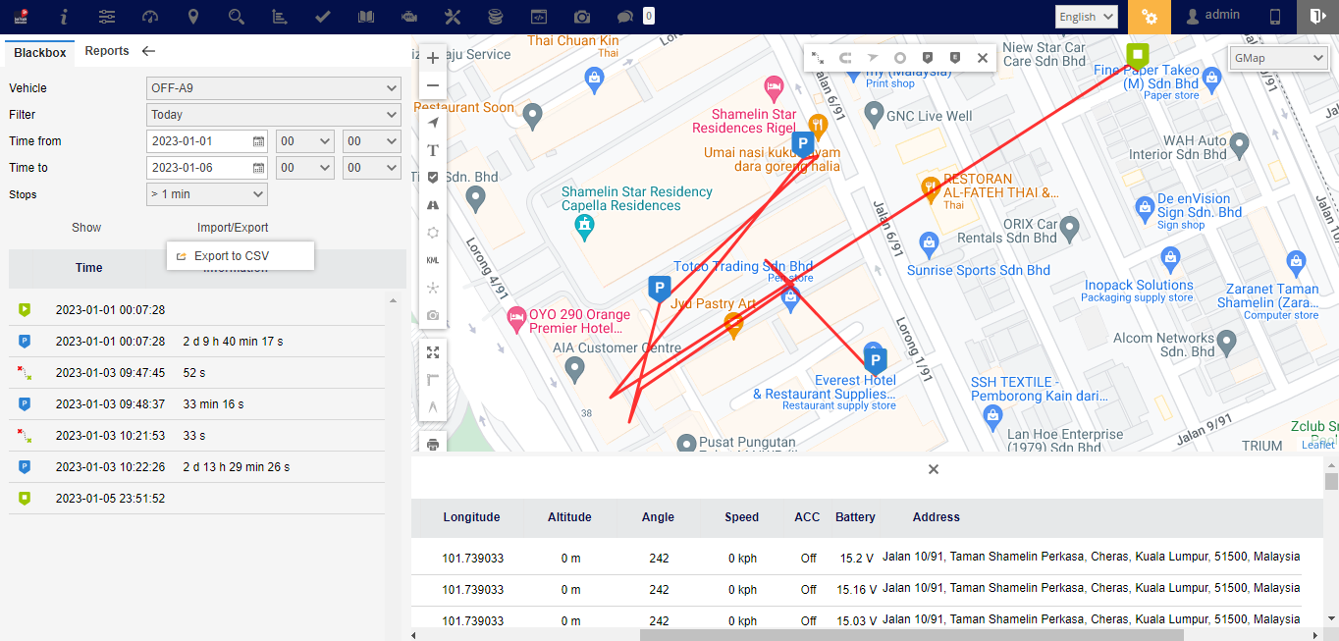
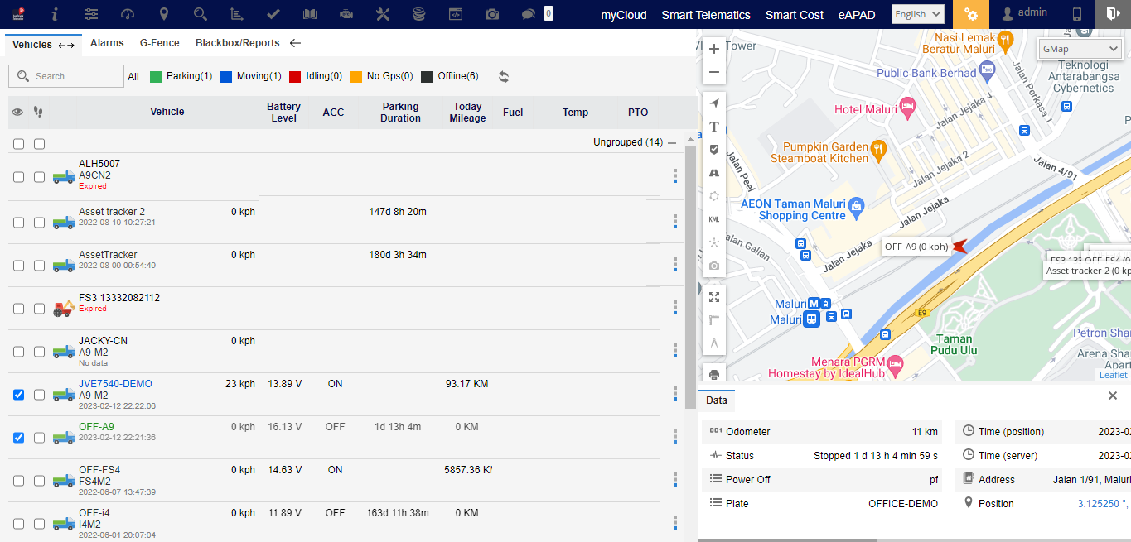
Screenshots :
--
--
Homepage
Blackbox

Slide 18
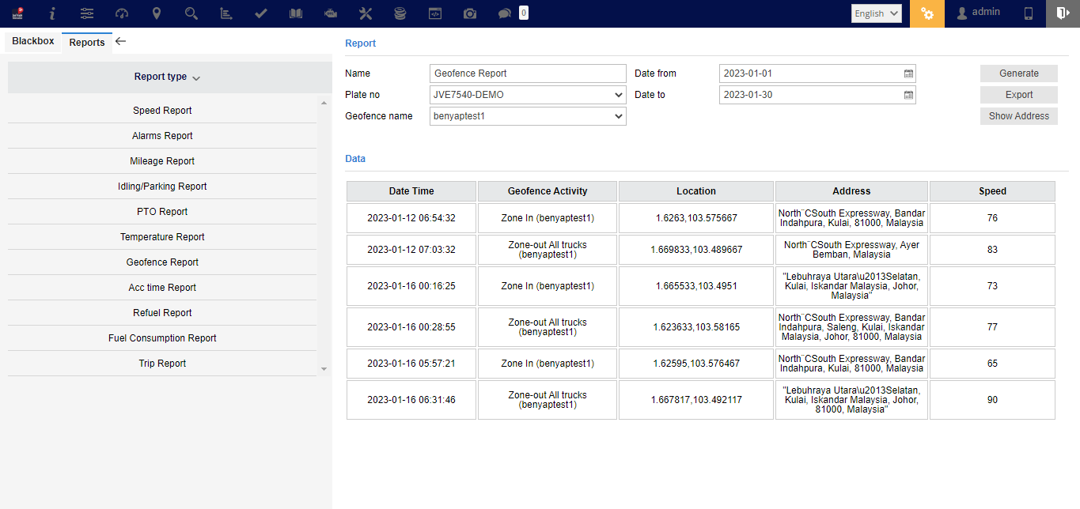
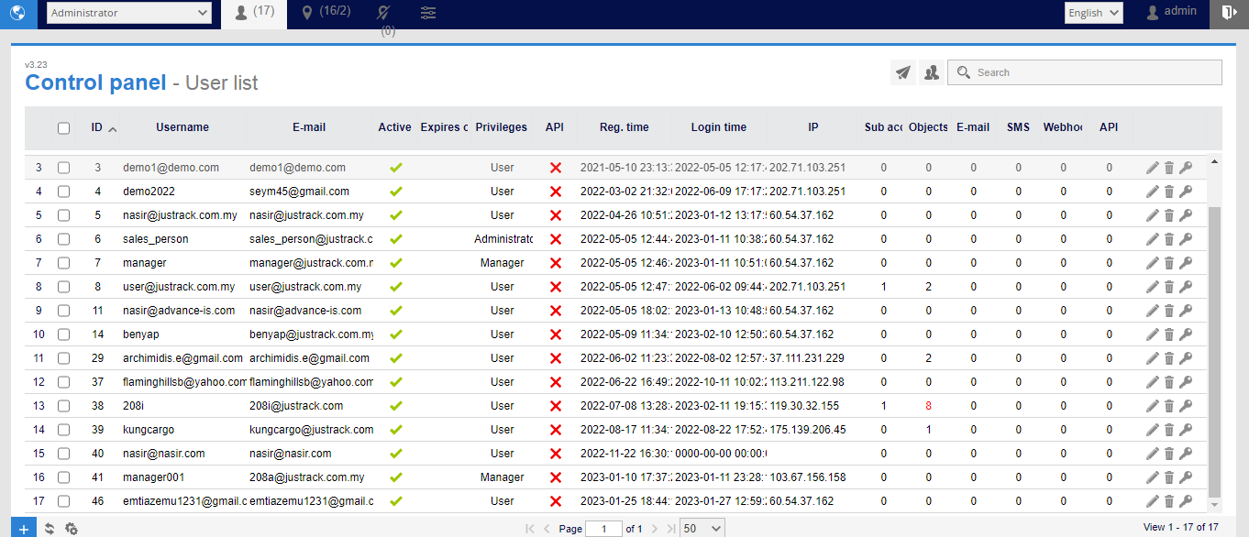
Screenshots :
Control panel
Reports

Slide 19
Project 4
Brand Name: MYBD HR for SARPV
Type: Human Resource Management System
Client Location: Bangladesh
URL: https://mybd.link/sarpv/
Features:
Employee login , password recovery system and separate dashboard according to employee’s designation.
Dashboard has overall information about employee’s project related information's.
New staff, project, designation , notice , appointment etc. can be added and edited.
Leave management system.
Monthly salary and bonus generation system.
Attendance system.
Staff related data can be uploaded from excel files.
Payslip , offer letters can be exported as pdf files.

Slide 20
Technologies:
Frontend:
UI is coded using: HTML5, Css3 , Bootstrap4.
Page’s interactive functionalities are achieved using: Javascript, Jquery.
Grids are created using Jquery Data Tables.
AJAX.
Backend:
PHP
MySQL database

Slide 21
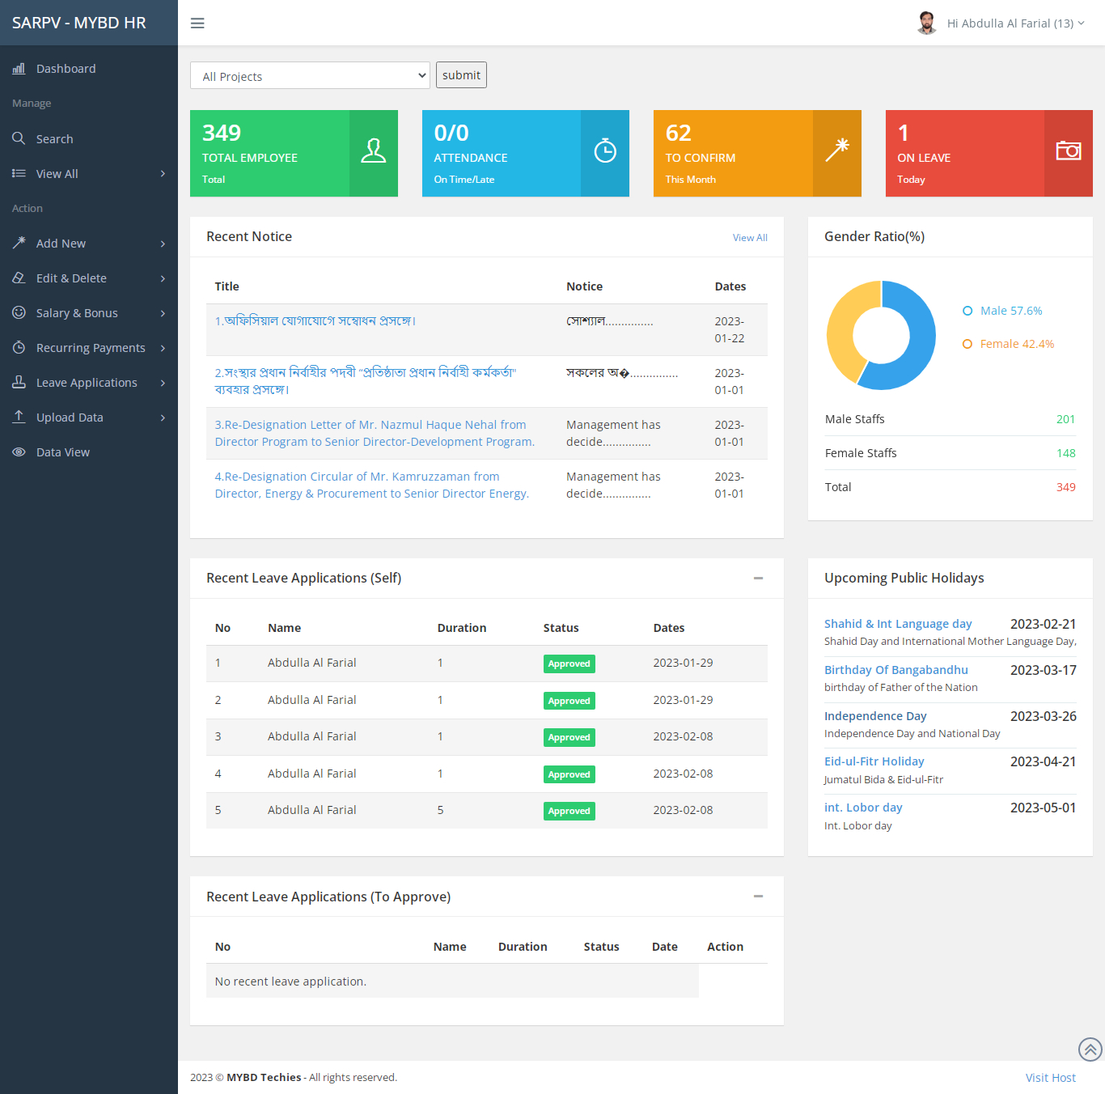
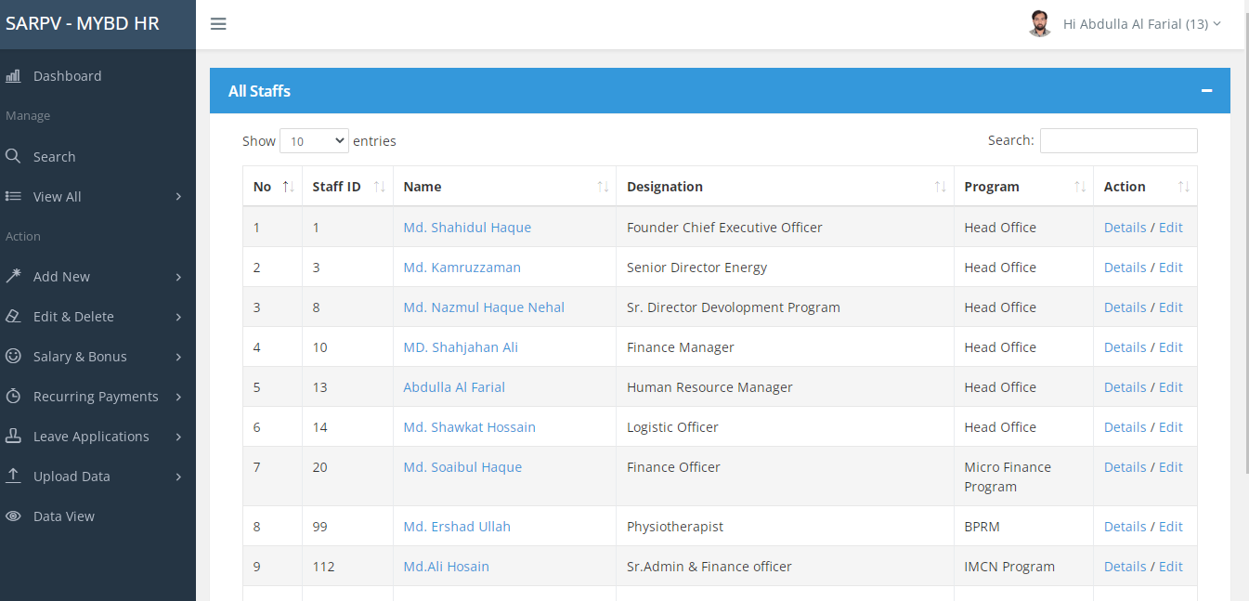
Screenshots :
Dashboard
All Staff

Slide 22
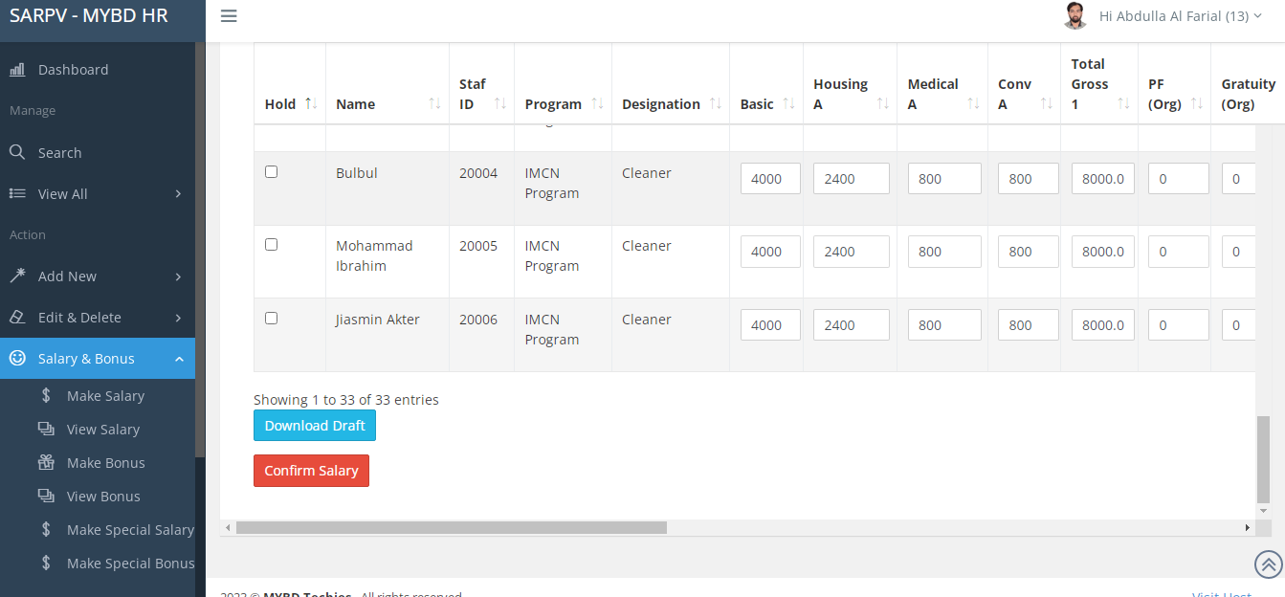
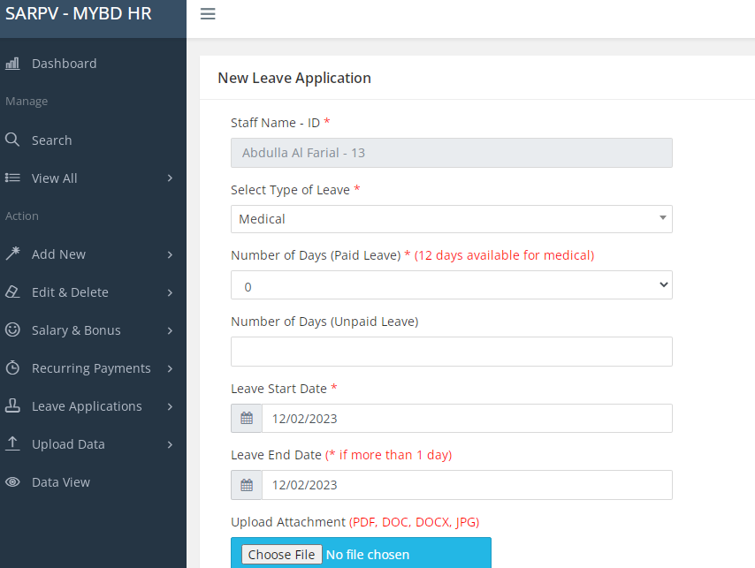
Screenshots :
Make Salary Sheet
New Leave Application

Slide 23
Project 5
Brand Name: Futuro
Type: Job listing website (Work in Progress)
Client Location: Malaysia
URL: http://mybd.tech
Features:
Search jobs.
View job details.
Register a new user.
Create new job only for registered user.
Attendance system.
Browse by pagination.

Slide 24
Technologies:
Frontend:
Full responsive UI is coded using: HTML5, Tailwind CSS.
Backend:
PHP
Laravel 8
MySQL database

Slide 25
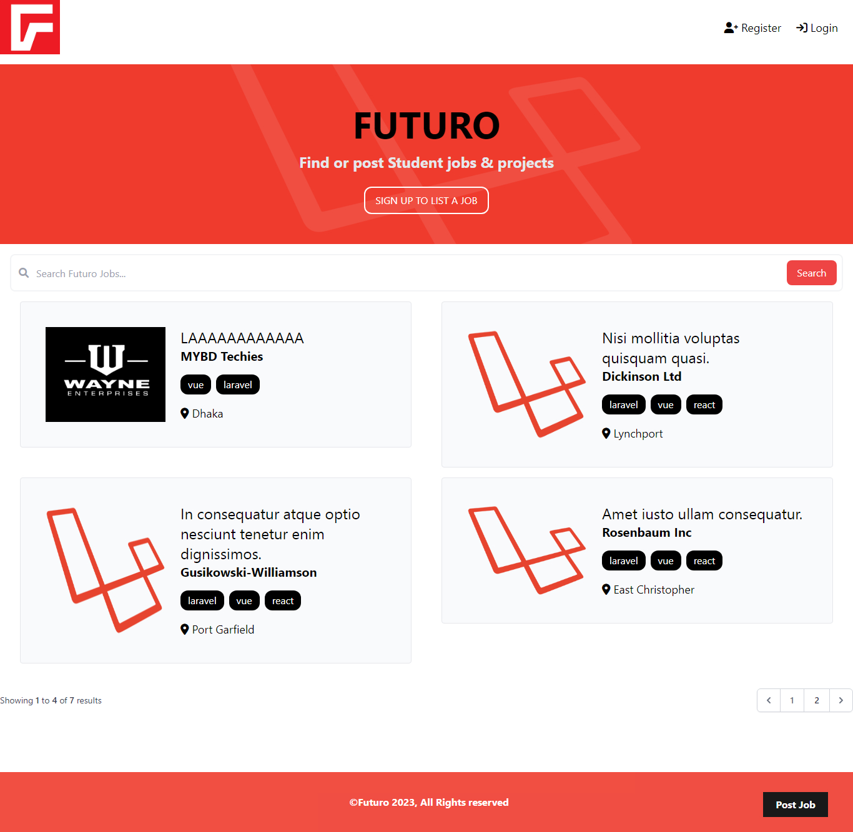
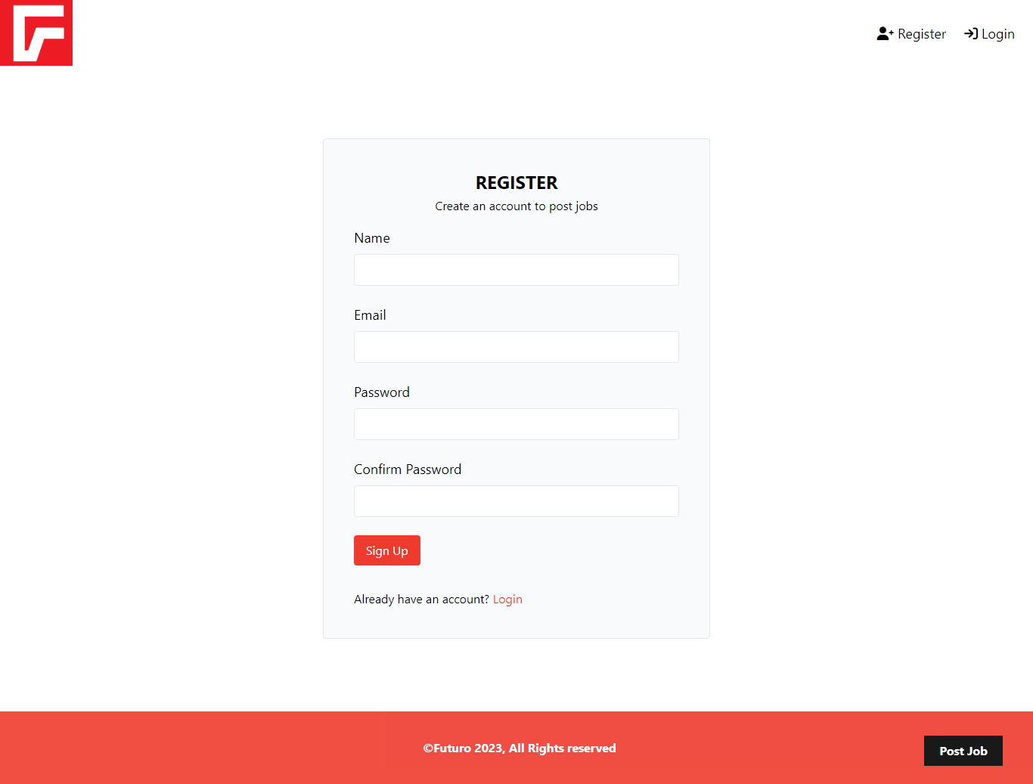
Screenshots :
Homepage
User Registration

Slide 26
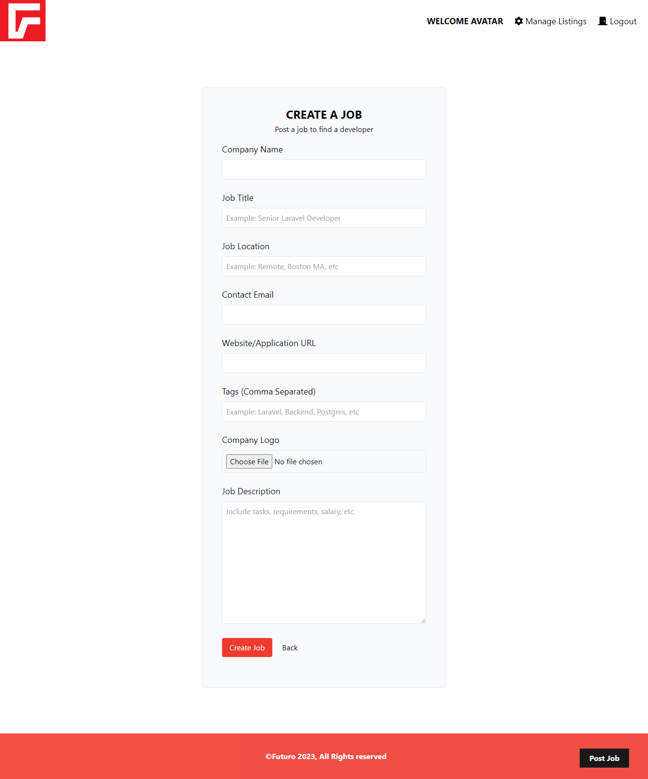
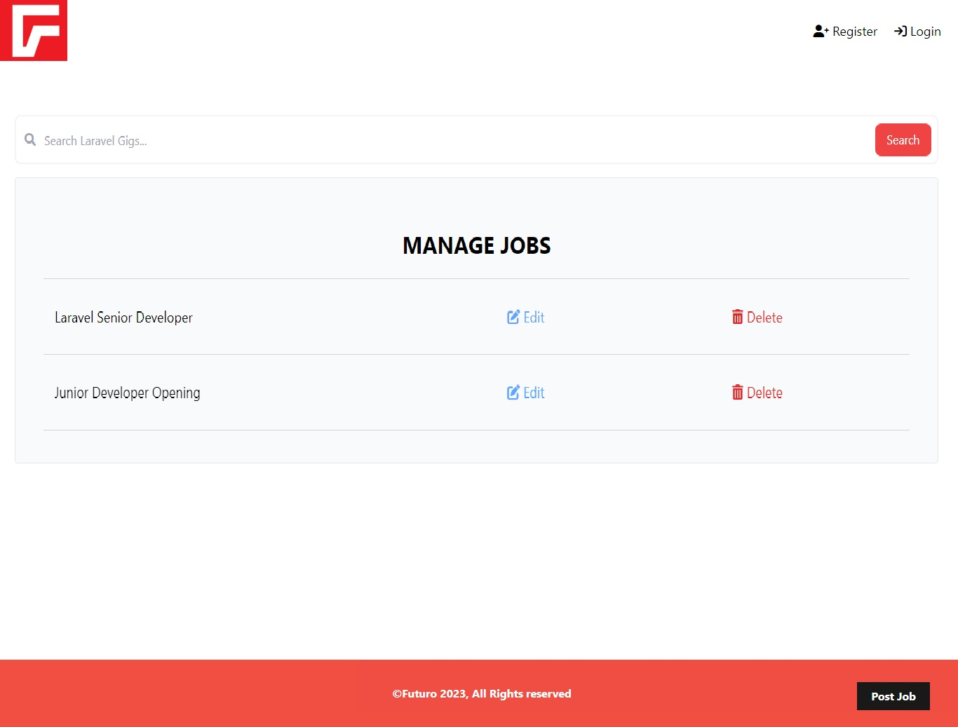
Screenshots :
Create New Job
Job Management

Slide 27
THANK YOU
If you have any questions…
emtiazemu1231@gmail.com
+880 1727 4424 60 (WhatsApp)
.

